Slide 1
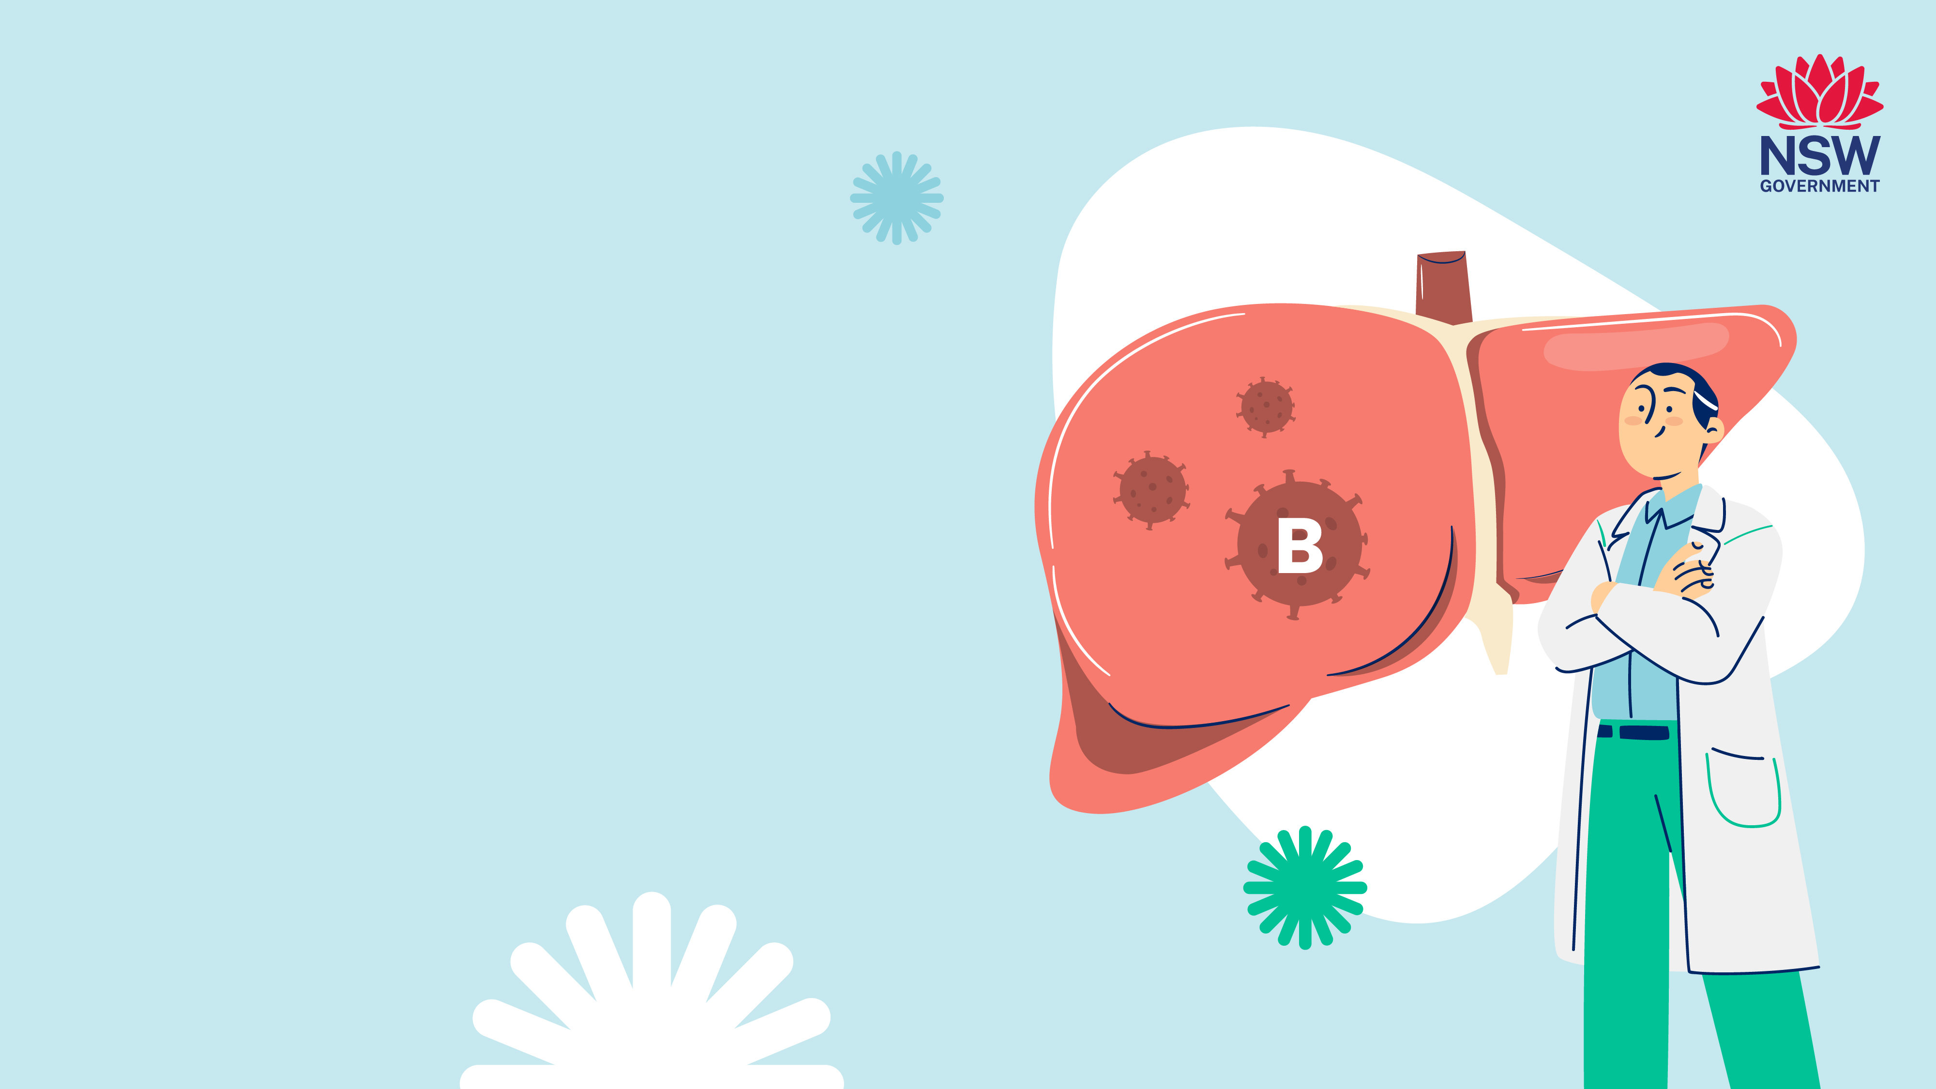
Understanding
Hepatitis B

Slide 2

Why does hepatitis B matter?
Hepatitis B matters because it can
lead to serious liver damage and
liver cancer if left untreated.
Chronic hepatitis B is
common in our communities.
Chronic hepatitis B can affect anyone.

Slide 3

Today we will talk about…
What you need to know about hepatitis B
with a focus on chronic hepatitis B
How you get hepatitis B and possible symptoms
Who should be tested
Where and how to get tested
Preventing and treating hepatitis B
Who do you tell and not tell
Where to get more information

Slide 4

What is
hepatitis B?
Hepatitis means inflammation of the liver
Hepatitis B is a liver infection caused by the hepatitis B virus
It can be acute (short-term) or chronic (long-term)
Chronic hepatitis B can cause liver damage and liver cancer
Many people living with chronic hepatitis B
don’t know they have it.
In Australia, most people with chronic hepatitis B
were born in countries where hepatitis B is common

Slide 5

What happens when
you get hepatitis B?
Acute (short term)
Chronic (long term)
Acute hepatitis B is when a person (usually an adult) gets rid of the virus within 6 months.
Chronic hepatitis B is when
the infection lasts more than
6 months.
Once they clear it, they cannot be infected with the hepatitis B virus again and cannot pass it on to others.
Chronic hepatitis B can lead to liver damage (cirrhosis) and liver cancer.

Slide 6

The younger a person is when they get
hepatitis B, the higher the risk of developing
chronic hepatitis B as an adult
Approximate number of people who will develop chronic hepatitis B as adults
90% of babies who get infected will not clear the virus and will develop chronic hepatitis B
95% of adults who get infected with the hepatitis B virus will clear it within 6 months

Slide 7
How does hepatitis B
affect your liver?
Healthy
liver
Acute hepatitis B
(short term)
Chronic hepatitis B
(long term)
Liver damage (cirrhosis)
Liver cancer
Getting tested now may help prevent liver complications in the future!

Slide 8

How do you
get hepatitis B?
When body fluids (blood, semen, saliva or
vaginal fluids) from someone with hepatitis B
enter the body of another person.
Through having sex without protection with a
person who has hepatitis B (either acute or chronic)
Through sharing equipment to inject drugs
Through sharing razors or other personal items
that may contain blood, including those used
for cultural rituals
This includes amounts of blood too small to
be seen

Slide 9
How do you get
chronic hepatitis B?
From a mother with hepatitis B (either acute or chronic) to her baby at birth if the baby is not vaccinated.
From a child with
hepatitis B to other children through cuts on the skin if they are not covered.
90% of babies who get infected will not clear the virus and will develop chronic hepatitis B
95% of adults who get infected with the hepatitis B virus will clear it within 6 months

Slide 10
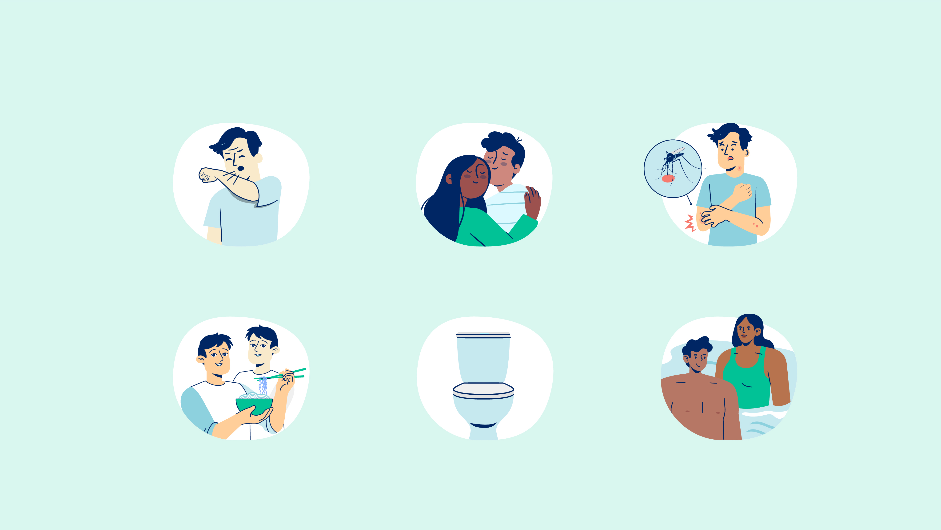
You cannot get
hepatitis B from...
Coughing or sneezing
Hugging, kissing or holding hands
Mosquito or other
insect bites
Sharing food, eating
utensils or drinking glasses
Sharing a bathroom or toilet
Swimming
pools

Slide 11

What are the
symptoms of hepatitis B?
Stomach pain
Dark urine
Fatigue
Nausea, vomiting or loss of appetite
Pale stools
Yellow skin and eyes (jaundice)
Acute hepatitis B
Stomach pain on the right side of the body
Aches, pains and fevers
Anxiety or depression
Diabetes
Nausea, vomiting or loss of appetite
Skin rashes or itchy skin
Yellow skin and eyes (jaundice)
Chronic hepatitis B

Slide 12

The only way to know if you have
chronic hepatitis B is by getting
a hepatitis B blood test
It’s quick
and easy

Slide 13

Testing for
hepatitis B
The tests results will tell you if you:
Have chronic hepatitis B infection, and need
care and treatment
Have developed protection against hepatitis B,
and cannot get it again
Don’t have protection against hepatitis B, and
need a hepatitis B vaccination.
There are different types of blood tests for hepatitis B, they are easy and confidential.
Where to get tested:
General Practitioner (GP)
NSW Sexual Health Clinics
Family Planning Australia

Slide 14
Who should get
a hepatitis B test?
If you were born or have lived in a country where hepatitis B is common, it is important you have a hepatitis B test
It is also important to get tested for hepatitis B if you:
Have a family member who has hepatitis B
Live with someone with hepatitis B
Have had sex without a condom
Have had medical, dental or cosmetic procedures overseas
where the equipment used was not clean
Have hepatitis C or HIV
Have injected drugs or steroids
Had a blood transfusion overseas, or before 1990 in Australia.

Slide 15

Treating chronic hepatitis B
If you have chronic hepatitis B you need to see your doctor regularly (every 6-12 months) to check the health of your liver, as liver damage can happen at any time.
Treatment can reduce damage to the liver and reduce the risk of liver cancer.
Your doctor will tell you
if you need to go on treatment

Slide 16

How do I protect myself from getting hepatitis B?
Get vaccinated
Vaccination is the best way to be protected against hepatitis B.
In Australia, the hepatitis B vaccination is free for:
newborn babies
children and adolescents
family and people in close contact with
someone who has hepatitis B.
Ask your doctor about the
hepatitis B vaccination

Slide 17
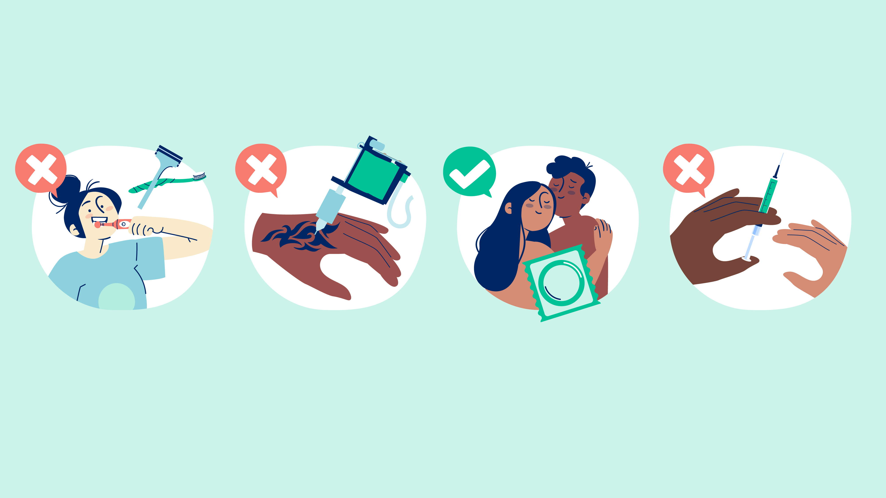
Other ways to stop
the spread of hepatitis B
Avoid blood-to-blood contact: do not share razors, toothbrushes or other personal items
Do not share needles or equipment for tattooing, piercing, or other traditional practices
Always use a condom and lubricant when you have sex
Do not share needles or any equipment used for injecting drugs

Slide 18

Understanding stigma around
hepatitis B
Many people living with viral hepatitis are affected by stigma associated with
hepatitis B because of:
Assumptions about how they got hepatitis B
Behaviours associated with hepatitis B.
These assumptions can influence
a person’s willingness to disclose
their hepatitis B status.
Stigma creates barriers to
healthcare and support.

Slide 19

Who to tell and not tell
By law you must tell people:
When you give blood
When donating organs and sperm
When you apply for insurance
If you join the Australian Defense Force
When you apply for a visa to live in Australia
If you are a health care worker
who does medical procedures
You do not have to tell:
Your boss at work
The people you work with
or go to school with
Family members
Health professionals

Slide 20

Where to
get help
Your doctor or GP
Liver clinics and specialists - 1800 803 990
www.hep.org.au
No Medicare card required
Sexual health clinics - 1800 451 624
www.health.nsw.gov.au/sexualhealth
Multicultural HIV and Hepatitis Service
www.mhahs.org.au
Hepatitis NSW – 1800 803 990
www.hep.org.au

Slide 21
Where to get help
in your language
If you need assistance with
talking to your doctor or health
provider in your language:
Call the Translating and Interpreting Service (TIS) on 13 14 50
The service is free and confidential
Ask the receptionist to book a free interpreter for you.
21

Slide 22

What have we
learnt today?
True or False?
You can get hepatitis B from having sex without condom.
The only way to know I have hepatitis B is when
skin becomes yellow.
You can protect yourself from getting hepatitis B
by taking vitamins and eating healthy food.
You should get tested if you have had a tattoo overseas
and are not sure if the equipment used was clean.

Slide 23

Important messages
to take away
Hepatitis B is a liver infection caused by the hepatitis B virus
Chronic hepatitis B (long term) is common in our communities
Chronic hepatitis B is passed on from mother to child at birth
The only way to know if you have hepatitis B is to get a
hepatitis B blood test
Treatment is available. It is safe and effective
Without treatment chronic hepatitis B can lead to liver
damage and liver cancer.

Slide 24

Questions?

Slide 25
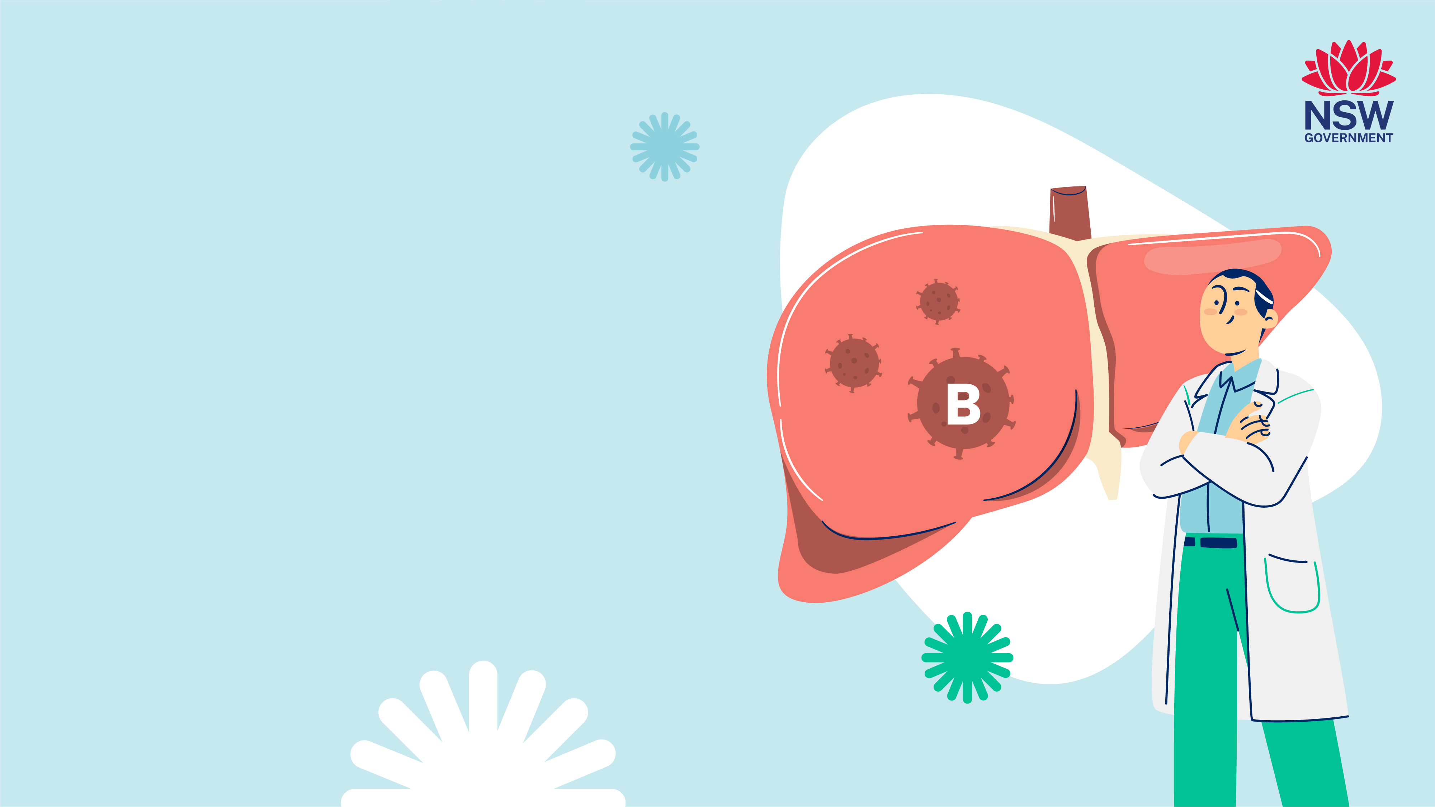
Developed by:
NSW Multicultural HIV
and Hepatitis Service
(MHAHS) mhahs.org.au
August 2025

